Slide 1

Welcome to Me
By: Nicholas Frazee

Slide 2
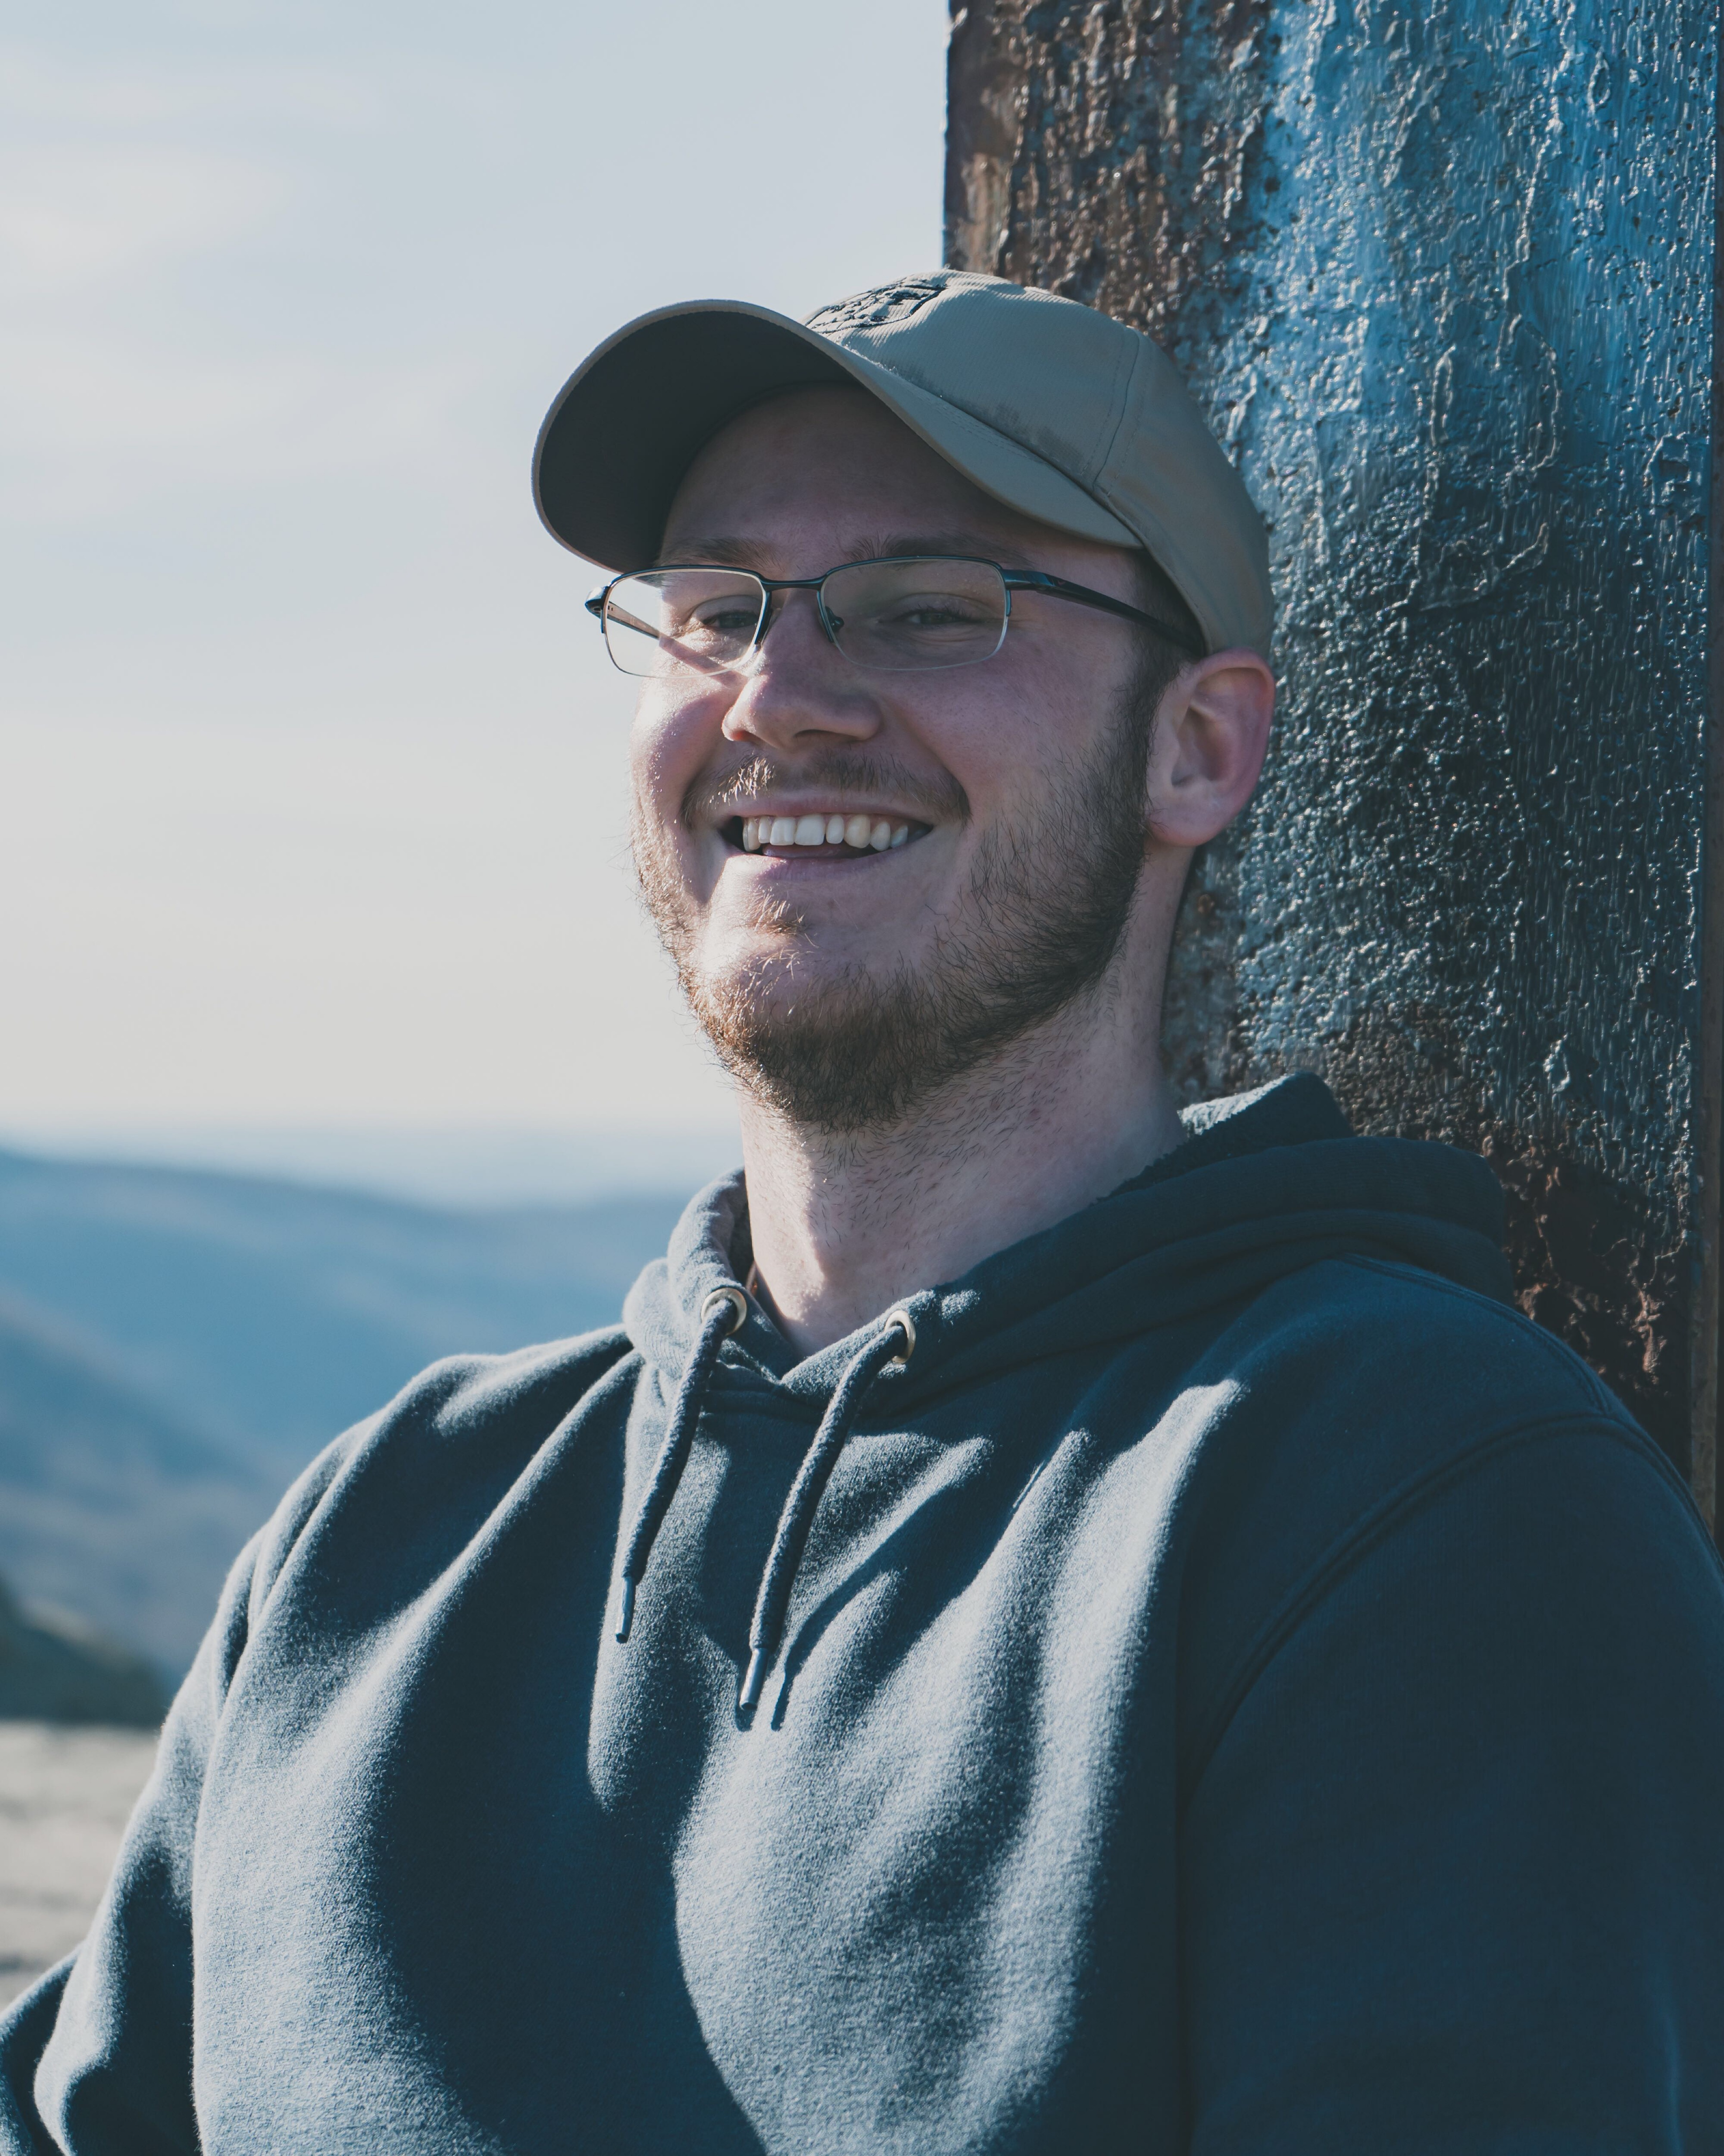
A Little About Myself
Senior at WVU
Originally from Wilmington Delaware
Interests:
  Health
  Sports
  Performance Enhancement

Slide 3
Education
West Virginia University
  Class of 2021 (Expected)
  Sport and Exercise Psychology major
  Minors in Professional Sales and Human Services
  50 hours of community service

Slide 4
Work Experience
West Virginia University Rec Center (11/8/2018-3/13/2020)
  Equipment Repair Technician
    Worked in a high paced area
    Had to think of solutions to equipment issues
    Interacted with students
    Gained knowledge of fitness equipment, and how to fix them

Slide 5
Work Experience cont.
Get Fit Juices & Shakes (9/23/2020-Current)
  Manager/Supervisor
    Oversee night shift operations
    Make schedules
    Call in orders from suppliers
    Handle upset customers

Slide 6
How Can I Benefit You?
Very hard working
Efficient in Microsoft Office
Managerial experience
Good time management skills
Diverse range of knowledge in multiple fields

